Slide 1
Population structure

Slide 2
What is population structure?
Population consists of discrete sub-populations that do not mix: allele frequencies vary between sub-populations.
Population consists of admixed individuals: different proportions of their genomes are descended from previously discrete subpopulations.
At the finest-scale, related individuals from the same family can be thought of sub-populations.
Population structure will impact on GWAS if disease prevalence (or trait distribution) varies between subpopulations.

Slide 3
Population structure in case-control studies
Population consists of underlying subpopulations.
Disease prevalence different between subpopulations.
Cases preferentially ascertained from specific subpopulations.
False positive evidence of association will occur at genetic markers that differ in genotype frequencies between the subpopulations.
CASES
CONTROLS

Slide 4
Example
 | Subpopulation 1 | Subpopulation 2 | Overall
Frequency | 0.5 | 0.5 | 1
Pr(MM) | 0.1 | 0.9 | 0.5
Pr(Disease) | 0.9 | 0.1 | 0.5
Pr(Disease & MM) | 0.09 | 0.09 | 0.09
Population consists of two equally frequent isolated sub-populations.
In the population overall: Pr(Disease & MM) < Pr(Disease) Pr(MM)
If we ascertain individuals without regard to subpopulation, cases tend to be selected from subpopulation 1, which has a low frequency of the MM genotype.

Slide 5
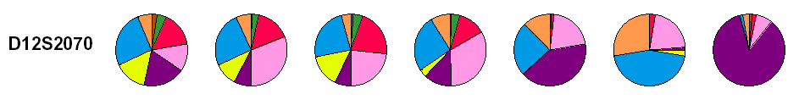
Variation across populations
Population | Cancer prevalence per 100,000 indivduals
 | Breast | Lung | Prostate
White hispanic | 93 | 34 | 140
White non-hispanic | 148 | 65 | 163
Black | 122 | 81 | 272
Asian or Pacific islander | 97 | 43 | 100
American indian | 58 | 33 | 54

Slide 6
Matching
One solution to the problem is to allow for structure at the design stage, by matching cases and controls for ethnic group.
When a case is selected from a given ethnic group, a matched control is selected from the same group.
Matched case-control studies require a matched analysis.
However, there may be fine-scale structure within ethnic groups or population admixture that cannot be accounted for by matching.
Apparent association between SNPs and type 2 diabetes in Pima Indians.
Type 2 diabetes occurs with greater prevalence in Caucasian individuals.
Association due to population admixture: cases tended to have a greater proportion of Caucasian ancestry, and allele frequencies vary between the ancestral populations.

Slide 7
Solutions to the problem
We can eliminate the problem of population structure by collecting family data.
Family-based association designs ascertain affected cases and their parents.
Form “internal” controls from alleles not transmitted from the parents to the child, effectively matching for ancestry.
Less powerful since two parents are required to form a single matched control.
Parental data may not always be available, e.g. for late-age onset diseases.
For unrelated samples of cases and controls, we can make use of genotype data across the genome to make inferences about and/or adjust for population ancestry.
In the presence of structure, there will be many more (false) positive signals of association than we would expect by chance.

Slide 8
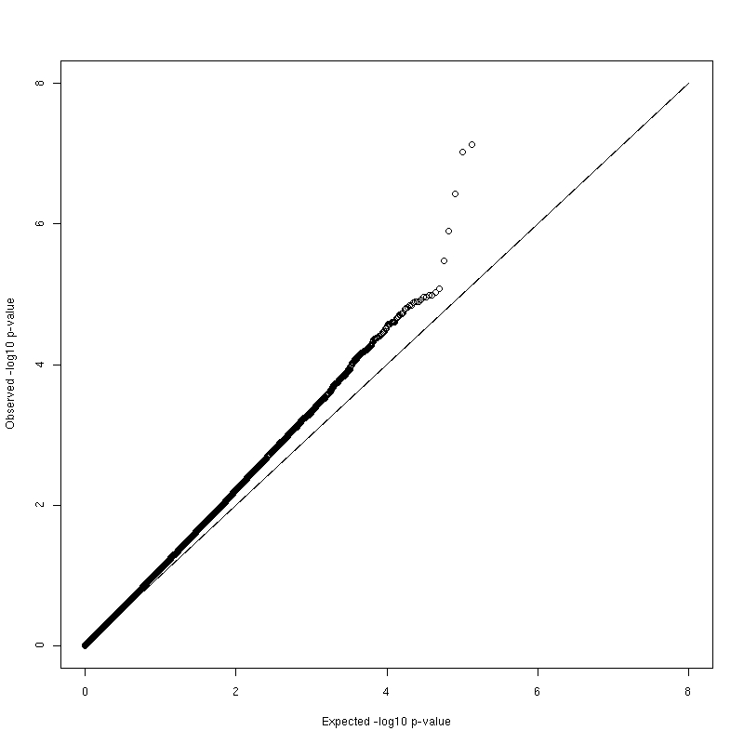
Genomic control
Devlin and Roeder (1999) used theoretical arguments to propose that with population structure, the distribution of Cochran-Armitage trend tests, genome-wide, is inflated by a constant multiplicative factor λ.
We can estimate the multiplicative inflation factor using the statistic λ = median(X_{i}²)/0.456.
Inflation factor λ > 1 indicates population structure: λ > 1.05 often considered “inflated”.
We can carry out an adjusted test of association that takes account of any mismatching of cases/controls at any SNP using the statistic X_{i}²/ λ.
True hits?
Population outliers and/or structure?
Inflation factor λ = 1.11

Slide 9
LD-score regression
Genomic control considers all SNPs to contribute independently to association signal.
Highly polygenic traits will show strong association signals across the genome because of LD.
LD-score of a variant measures amount of genetic variation tagged by that variant: can be estimated from reference panels, such as 1000 Genomes Project.
LD-score regression intercept measures inflation in association test statistics after accounting for LD.
If LD-score intercept is less than the GC inflation factor, there is evidence of polygenicity.
Can correct association test statistics by LD-score intercept in the same way as GC inflation factor.

Slide 10
Multivariate techniques
Principal components analysis (PCA) has become a standard tool in genetics to study geographic variation in allele frequencies.
Assumes individuals are unrelated.
PCA is used to infer continuous axes of genetic variation (eigenvectors) that reduce the data to a small number of dimensions, whilst describing as much of the variability between individuals as possible.
We can make use of PCA in GWA studies to:
identify “population outliers” using genotype data available from the HapMap project;
generate axes of genetic variation to account for structure within the study population.

Slide 11
Population outliers
The International HapMap Project provides high-density genotype data for three reference populations:
30 CEPH trios from Utah with Northern European ancestry (CEU);
30 Yoruba trios from Ibadan, Nigeria (YRI);
45 unrelated Japanese individuals from Tokyo (JPT) and 45 unrelated Han Chinese individuals from Beijing (CHB).
HapMap samples can be used to define two axes of genetic variation that broadly distinguish populations of European, African and Asian ancestry.
Perform PCA with genotype data from GWA study combined with that from reference HapMap samples at same SNPs.
NOTE: SNPs included in PCA should be autosomal, independent (i.e. not in LD with each other) and usually chosen to have MAF>5%.
Exclude population outliers from association analysis.

Slide 12
Example: UK WTCCC1
Afro-Caribbean samples
South Asian samples
QC filtered samples genotyped at ~400K clean SNPs

Slide 13
Structure within populations
The same PCA techniques can be applied to genotype data from GWA study without using HapMap samples as reference.
Axes of genetic variation can be used to investigate “finer-scale” structure within the study population.
May reflect fine-scale structure confounded with disease that could inflate genotype-phenotype association statistics.

Slide 14
Example: European population structure
1,387 samples
~200K SNPs
Novembre et al. (2008).

Slide 15
Adjusting for population structure
Axes of genetic variation can be used as covariates within logistic regression modelling framework to adjust for underlying population structure.
How many axes of genetic variation should be included?
No pre-defined recipe!
Visual inspection of axes plotted against each other. Do these highlight “clusters” of cases/controls?
Sequential addition of axes of genetic variation until genomic control or LDSC intercept reach acceptable levels.
Test for association of each axis with phenotype, and adjust for those that are significant, since these are most likely to be confounded.

Slide 16
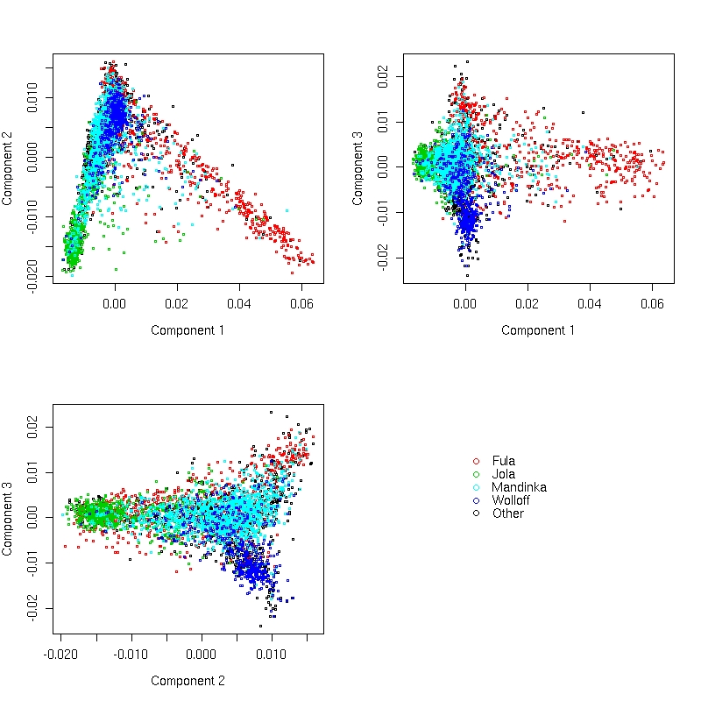
Example: African WTCCC1
Whole genome association study of tuberculosis in the Gambia: part of the WTCCC.
Axes of genetic variation calculated using PCA applied to ~100,000 (independent) SNPs genome-wide.
Four common ethnic groups separated by first three components of MDS.
Inclusion of these components as covariates reduces genomic control statistic from 1.13 (no adjustment) to 1.05 (three components).

Slide 17
Software
PCA can be performed in PLINK in two ways:
Create genome file based on pair-wise identity by state between individuals (also used to detect relatedness) and construct principal components using multi-dimensional scaling;
Principal components analysis on genotype data directly;
Important to perform analysis on LD pruned autosomal SNPs, typically MAF>5%.
SMARTPCA software can be used to perform PCA analysis and can:
generate any number of axes of genetic variation;
remove outliers on the basis of deviation along axes of genetic variation;
test for association between each axis of genetic variation and disease to determine which may be confounded;
take account of LD between SNPs.

Slide 18
Linear mixed models (LMMs)
LMMs have been used for many years in the plant and animal breeding communities.
In the mid 1990s they became popular in the human genetics for performing linkage analysis using family (pedigree) data.
More recently, they have become popular in GWAS for testing association while accounting for varying degrees of “relatedness”.
Thanks to Heather for help in preparing these slides!

Slide 19
Fixed and random effects
A linear mixed model is a statistical model in which the dependent variable is a linear function of both fixed and random independent variables.
Fixed effects are considered “fixed” at their measured values.
Random effects are considered to be sampled from a distribution.

Slide 20
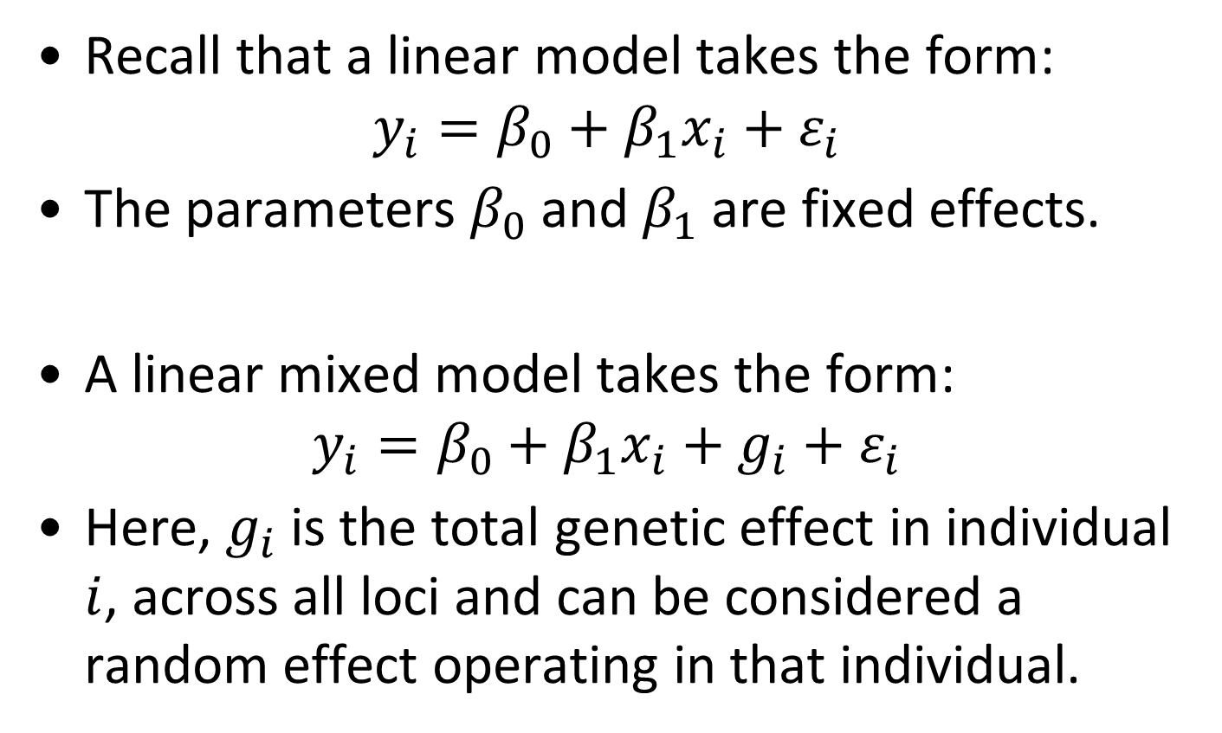
Linear model and LMM
Recall that a linear model takes the form:
$$y_{i}=β_{0}+β_{1}x_{i}+ε_{i}$$
The parameters $β_{0}$ and $β_{1}$ are fixed effects.
A linear mixed model takes the form:
$$y_{i}=β_{0}+β_{1}x_{i}+{g_{i}+ε}_{i}$$
Here, $g_{i}$ is the total genetic effect in individual $i$, across all loci and can be considered a random effect operating in that individual.

Slide 21
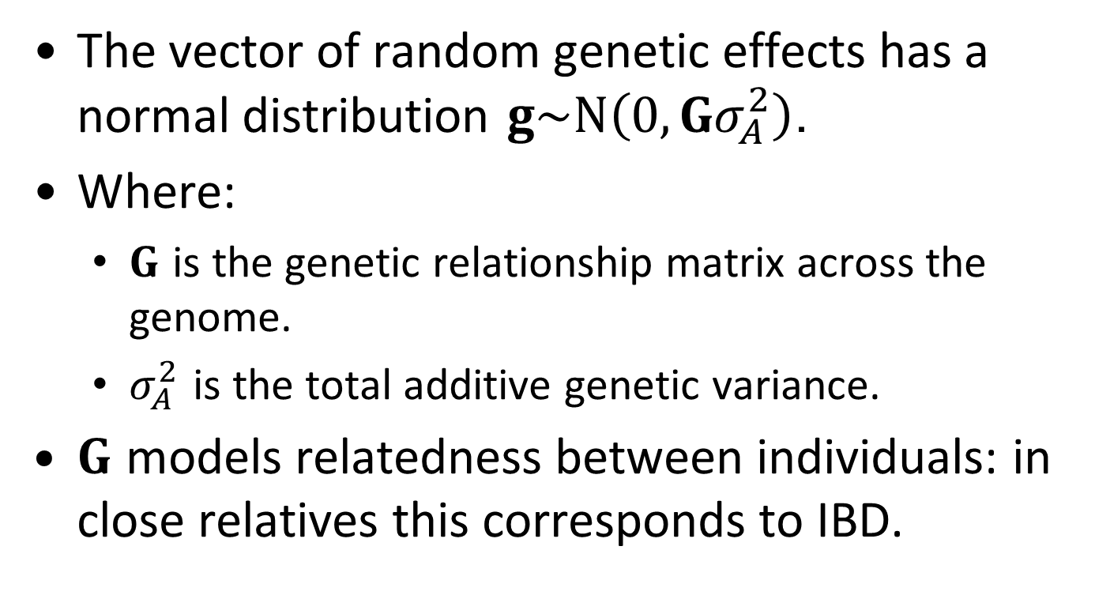
Random genetic effects
The vector of random genetic effects has a normal distribution $g\sim N\left(0,Gσ_{A}^{2}\right)$.
Where:
$G$ is the genetic relationship matrix across the genome.
$σ_{A}^{2}$ is the total additive genetic variance.
$G$ models relatedness between individuals: in close relatives this corresponds to IBD.

Slide 22
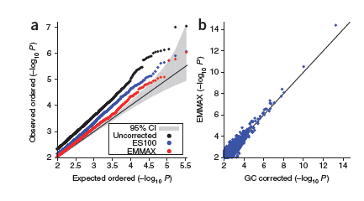
Example: NFBC66
HEIGHT LDL

Slide 23
Comments
LMMs allow for relatedness: so no need to remove related individuals as part of QC.
Has advantage over genomic control of correcting for population structure for each SNP independently.
Can allow for cryptic relationships that cannot be accounted for with multivariate techniques.
LMMs assume quantitative outcome, but can be applied to binary traits, although some care is needed in interpretation of results.

Slide 24
Software for mixed models
EMMAX
FaST-LMM
GEMMA
GenABEL (GRAMMAR-Gamma)
GCTA
BOLT-LMM
GMMAT (logistic mixed model for binary traits)
SAIGE and REGENIE (allow for case-control imbalance in binary traits).

Slide 25
Other uses for mixed models
Estimating heritability based on GWAS data.
Partitioning heritability according to specific genomic features.
Estimating genetic correlation between traits.
Prediction of trait values: more common to use polygenic scores.

Slide 26
Adjusting for axes of genetic variation in LMMs
Axes of genetic variation can capture underlying geography.
Adjusting for axes of genetic variation in LMMs can allow for unmeasured environmental confounders that are correlated with geography.
Multivariate techniques should be applied to unrelated individuals: PC-Air can be used to select unrelated subset and project remainder onto axes of genetic variation.

Slide 27
Summary
Population structure can lead to spurious associations if disease prevalence and allele frequencies vary between subpopulations.
The GC inflation factor or LD-score intercept can be used as an indicator of the presence of population structure.
PCA can be used to construct axes of genetic variation that maximise the variability between individuals.
Plotting axes of genetic variation from PCA including HapMap samples can be used to identify population outliers.
Axes of genetic variation can be used as covariates in the association analysis to adjust for the effects of population structure.
Linear mixed models can be used to account for population structure and relatedness.
Can be applied to GWAS with related individuals.
Computationally efficient.
Can also be used to elucidate genetic architecture.

